Slide 1

Algebraic Techniques To Enhance Common Sub-expression Extraction for Polynomial System Synthesis
Sivaram Gopalakrishnan
Synopsys Inc., Hillsboro, OR – 97124
Priyank Kalla
Department of Electrical and Computer Engineering,
University of Utah, Salt Lake City, UT- 84112

Slide 2
Outline
Problem context: Polynomial datapath synthesis
Our Focus: Integrating CSE and Algebraic methods
Applications: DSP for audio, video, multimedia….
Motivation
Previous Work and Limitations
Integrated Approach
Square-free factorization
Common Coefficient Extraction
Common Cube Extraction
Algebraic Division
Results: Area Optimization
Conclusions & Future Work

Slide 3
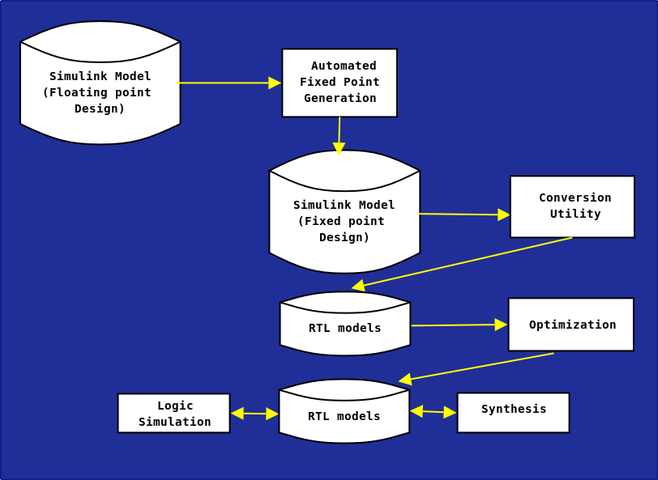
The Synthesis Flow

Slide 4
Polynomial representation?
Quadratic filter design for polynomial signal processing
y = a₀ . x₁² + a₁ . x₁ + b₀ . x₀² + b₁ . x₀ + c . x₀ . x₁

Slide 5
Motivation
P₁ = x² + 6xy + 9y²
P₂ = 4xy² + 12y³
P₃ = 2zx² + 6xyz
P₁ = x(x+ 6y) + 9y²
P₂ = 4xy² + 12y³
P₃ = x(2zx + 6yz)
P₁ = x(x+ 6y) + 9y²
P₂ = y²(4x+ 12y)
P₃ = xz(2x + 6y)
Direct Implementation
17 Mults & 4 Adds
Horner form
15 Mults & 4 Adds
Factorization + CSE
12 Mults & 4 Adds

Slide 6
Motivation
d₁ = x + 3y
P₁ = d₁²
P₂ = 4d₁y²
P₃ = 2xzd₁
d₁ is a good building block
How to identify such building blocks across multiple polynomial datapaths?
Need an methodology to expose many common expressions!!!
Our Approach
8 Mults & 1 Add

Slide 7
Conventional Methods
Extracting control-dataflow graphs (CDFGs) from RTL
Scheduling
Resource sharing
Retiming
Control synthesis
Algebraic Transforms for arithmetic designs
Factorization [Hosangadi et al, ICCAD 04]
Common Sub-expression Elimination [Hosangadi et al, VLSI 05]
Term-rewriting [Arvind et al, IEEE. Micro 98]
Tree-Height Reduction [De Micheli 94]
Lack of symbolic computer algebra manipulation

Slide 8
Conventional Methods…
Kernel/Co-kernel Extraction (Factorization + CSE)
Integrates CSE with cube/coefficient extraction
Uses coefficients and variables to identify cubes (co-kernels)
to obtain kernels
Subsequently uses CSE for further optimization
P = 5x² + 10y³ + 15pq;
Uses {5, 10, 15, x, y, p, q} for kernel/co-kernel extraction
Does not perform algebraic division
Cannot determine decomposition 5(x² + 2y³ + 3pq)
P = x² + 2xy + y²; -> (x+y)²
Cannot determine the above decomposition

Slide 9
Symbolic algebra techniques
Polynomial models for complex computational blocks
Guiding Synthesis engines using Gröbner’s basis [Peymandoust and De Micheli, TCAD 02]
Given polynomial F and Library elements <I₁, …, I_{n}>
F = h₁ I₁ + …… + h_{n} I_{n}
Restricted to library elements
Datapath optimization using word-length information
[Gopalakrishnan et al, ICCAD 07]
Restricted to fixed-size datapaths
Cannot address systems of polynomials

Slide 10
Optimization techniques
Canonical Form representation
∑c_{k}Y_{k}
c_{k} : Coefficient in the range (0 ≤ c_{k} ≤ b_{k})
Y_{k} : Falling factorial
F = 3x²y² - 3x²y - 3xy² + 3xy = 3x(x-1)y(y-1)
f₁ = 5x³y² - 5x³y - 15x²y² + 15x²y + 10xy² - 10xy + 3z²
f₂ = 3x²y² - 3x²y - 3xy² + 3xy + z + 1
d₁ = x(x-1)y(y-1)
f₁ = 5d₁(x-2) + 3z²
f₂ = 3d₁ + z + 1

Slide 11
Optimization techniques
Square-free factorization
Let F be an integral domain Z
A polynomial u in F[x] is square-free if there is no polynomial v in F[x] with deg(v, x) > 0, such that v² | u.
u₁ = x² + 3x + 2; u₁ = (x+1)(x+2) is square-free
u₂ = x⁴ + 7x³ + 18x² + 20x + 8;
u₂ = (x+1)(x+2)² is not square-free!!!

Slide 12
Optimization techniques
Common Coefficient Extraction
P = 8x + 16y + 24z;
P₁ = 2(4x + 8y + 12z);
P₂ = 4(2x + 4y + 6z);
P₃ = 8(x + 2y + 3z); best transformation
Use GCD computation
Get the coefficients (a_{is})
Compute GCD of every pair (a_{i}, a_{j})
Retain GCDs > atleast (a_{i}, a_{j})
Arrange GCDs in decreasing order, perform extraction
Update GCD list and continue…

Slide 13
Optimization techniques
Common Coefficient Extraction (Example)
P = 8x + 16y + 24z + 15a + 30b;
Coefficients {8, 16, 24, 15, 30}
GCD list {8, 8, 1, 2, 8, 1, 2, 1, 6, 15}
Reduced GCD list {8, 15} -> decreasing order {15, 8}
Extracting 15 results in
P = 8x + 16y + 24z + 15(a + 2b);
Similarly, extracting 8 results in
P = 8(x + 2y + 3z) + 15(a + 2b);

Slide 14
Optimization techniques
Common Cube Extraction
Similar to kernel/co-kernel extraction (for variables…)
P₁ = x²y + xyz;
P₂ = ab²c³ + b²c²x;
P₃ = axz + x²z²b;
kernel/co-kernel extraction results in
P₁ = xy(x + z);
P₂ = b²c²(ac + x);
P₃ = xz(a + xzb);

Slide 15
Optimization techniques
Polynomial long division
Given two polynomials a(x) and b(x), algebraic division determines q(x) and r(x) such that
a(x) = b(x) q(x) + r(x)
a(x) = x⁴ - 2x³ + 5;
b(x) = x² + 3x - 2;
a(x) = b(x) (x² – 5x + 17) – 61x + 39
q(x) r(x)

Slide 16
Optimization techniques
Common Sub-Expression Elimination
Identify isomorphic patterns in an arithmetic expression tree and merge them!!!
k = x + y;
m = x + y + z;
n = xy + x + y;
k = x + y;
m = k + z;
n = xy + k;

Slide 17
Integrated approach
Input: The polynomial system P_{orig} (list of arrays)
Perform Canonization, Square-free factorization
Get best initial cost: C_{initial}
Perform Coefficient extraction: P_{cce}
Perform cube extraction: P_{cce_cube}, get linear blocks
Get the lists representing the system
For every linear block, for each list perform algebraic division
Pick the best cost

Slide 18
Illustration

Slide 19
Integrated approach (Example)
P₁ = 13x² + 26xy + 13y² + 7x - 7y + 11;
P₂ = 15x² - 30xy + 15y² + 11x + 11y + 9; P_{orig}
Square-free factorization does not work!!!
Initial cost: 16 M and 10 A
After common coefficient extraction (P_{cce})
P₁ = 13(x² + 2xy + y²⁾ + 7(x – y) + 11;
P₂ = 15(x² - 2xy + y²⁾ + 11(x + y) + 9;
Linear blocks: (x – y), (x + y)

Slide 20
Integrated approach (Example…)
After common cube extraction (P_{cce_cube})
P₁ = 13(x(x + 2y) + y²⁾ + 7(x – y) + 11;
P₂ = 15(x(x- 2y) + y²⁾ + 11(x + y) + 9;
Linear blocks: (x – y), (x + y), (x + 2y), (x – 2y)
Perform algebraic division using the linear blocks
P_{cce} is the best cost implementation with (x+y) (x-y)
d₁ = x + y; d₂ = x - y;
P₁ = 13d₁² + 7d₂ + 11;
P₂ = 15d₂² + 11d₁ + 9;
Cost: 6 M and 6 A

Slide 21
Results
Benchmark | Var/Deg/m | Factor/CSE | Proposed | ↑Area % | ↑Delay %
SG3X2 | 2/2/16 | 204805 | 102386 | 50 | 21.3
SG4X2 | 2/2/16 | 449063 | 197599 | 55.9 | -24.1
SG4X3 | 2/3/16 | 690208 | 557252 | 19.2 | -16.3
SG5X2 | 2/2/16 | 570384 | 271729 | 52.3 | -13.9
SG5X3 | 2/3/16 | 1365774 | 614955 | 54.9 | -20.7
Quad | 2/2/16 | 36405 | 30556 | 16 | -9.5
Mibench | 3/2/8 | 20359 | 8433 | 58.6 | -3.7
MVCS | 2/3/16 | 31040 | 22214 | 28.4 | -32
Average area improvement: 42%

Slide 22
Results
Benchmark | Var/Deg/m | Factor/CSE | Proposed | ↑Area % | ↑Delay %
SG3X2 | 2/2/16 | 204805 | 102386 | 50 | 21.3
SG4X2 | 2/2/16 | 449063 | 197599 | 55.9 | -24.1
SG4X3 | 2/3/16 | 690208 | 557252 | 19.2 | -16.3
SG5X2 | 2/2/16 | 570384 | 271729 | 52.3 | -13.9
SG5X3 | 2/3/16 | 1365774 | 614955 | 54.9 | -20.7
Quad | 2/2/16 | 36405 | 30556 | 16 | -9.5
Mibench | 3/2/8 | 20359 | 8433 | 58.6 | -3.7
MVCS | 2/3/16 | 31040 | 22214 | 28.4 | -32
Average area improvement: 42%

Slide 23
Conclusions & Future Work
Polynomial decomposition approach for arithmetic datapaths
Arithmetic datapaths modeled as polynomial systems
Integrating CSE with algebraic manipulation
Performing algebraic decomposition to enhance the power of CSE
Impressive area savings
But delay penalty!!!
Future Work:
Address the concerns in delay!!!
Retarget the approach towards power savings???

Slide 24
Questions???

