Slide 1


Digital Electronics
Neil E Cotter
ECE Dept. University of Utah

Slide 2

Digital Electronics
Binary Numbers:
Voltages
Binary Add
Binary Multiply
Logic Gates:
NOT
OR
AND
NAND
DeMorgan

Slide 3

Digital Electronics
Binary voltages:
5V = 1
0V = 0

Slide 4
Digital Electronics
Binary Add:
0 + 0 = 0
0 + 1 = 1
1 + 0 = 1
1 + 1 = 10

Slide 5
Digital Electronics
Binary Multiply:
0 * 0 = 0
0 * 1 = 0
1 * 0 = 0
1 * 1 = 1

Slide 6

Digital Electronics
NOT

Slide 7

Digital Electronics
OR

Slide 8

Digital Electronics
AND

Slide 9

Digital Electronics
NAND

Slide 10
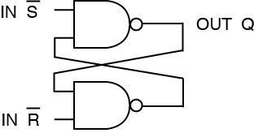
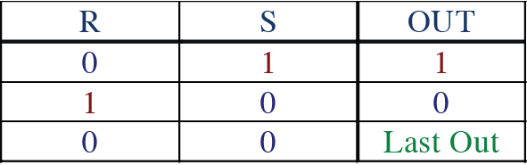
Digital Electronics
Flip-Flop

Slide 11
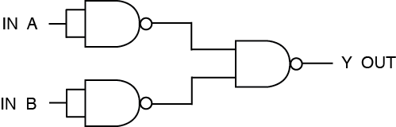
Digital Electronics
DeMorgan’s Theorem

